Slide 1




DrugMap
11,886 drug-like molecules from the DRUGBANK database (2020)
Grouped in 3 categories
Approved drugs
Withdrawn drugs
Drugs in development

Slide 2

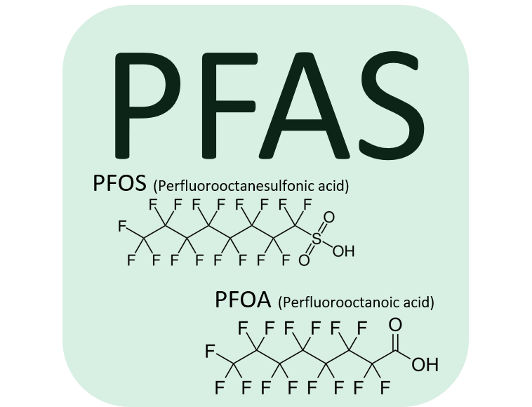




PFASMap
9,252 structures polyfluoroalkyl substances extracted from the EPA chemical dashboard (PFAS master list)
Grouped by Globally Harmonized System (GHS)
GHS=1
GHS=2
GHS=3
GHS=4
GHS=5
No GHS reported

Slide 3

Tox21Map
13,756 unique substances (8,947 unique) comprising the screening library for the Tox21 program, a multi-federal agency collaborative among the US EPA, NEHS/NTP, NIH/NCATS, and the US FDA.
Grouped by Globally Harmonized System (GHS)
GHS=1
GHS=2
GHS=3
GHS=4
GHS=5
No GHS reported

Slide 4
DSSToxMap
883,000 chemicals available on the EPA chemical dashboard, each navigation map included 10,000 chemicals center on the user choice chemical.
Grouped by Globally Harmonized System (GHS)
GHS=1
GHS=2
GHS=3
GHS=4
GHS=5
No GHS reported

Slide 5
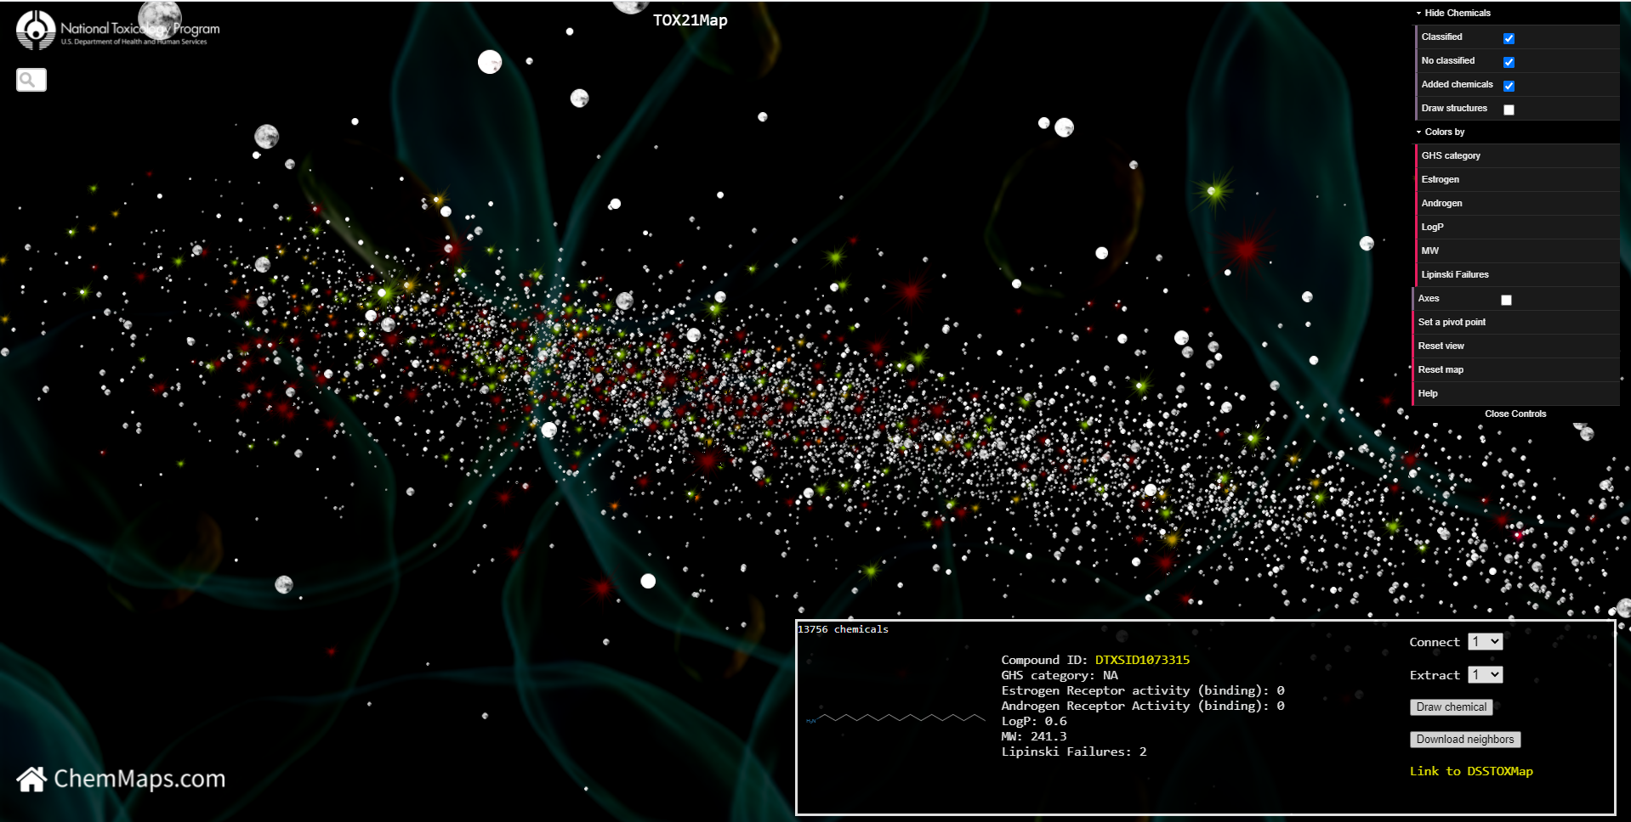

2.
1.
6.
3.
View blocked
7.
2x
Link to the map
Link to the NTP website
Search bar (using DSSTOX ID or Drugbank ID)
Link to the home page
Interactive chemical panel
Control panel
Block the view with double click
5.
4.

Slide 6


Mouse-based navigation
2.
1.
3.
4.
navigate on map
zoom in / zoom out
rotate the map
moved the map

Slide 7

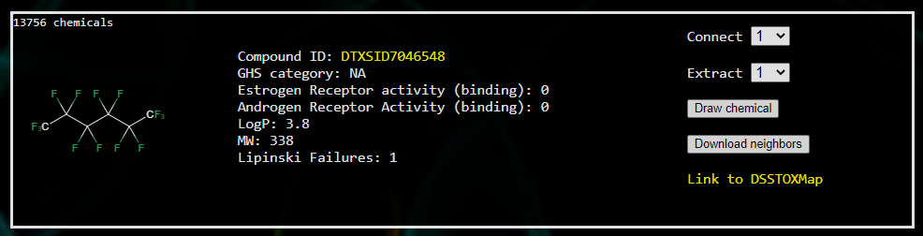
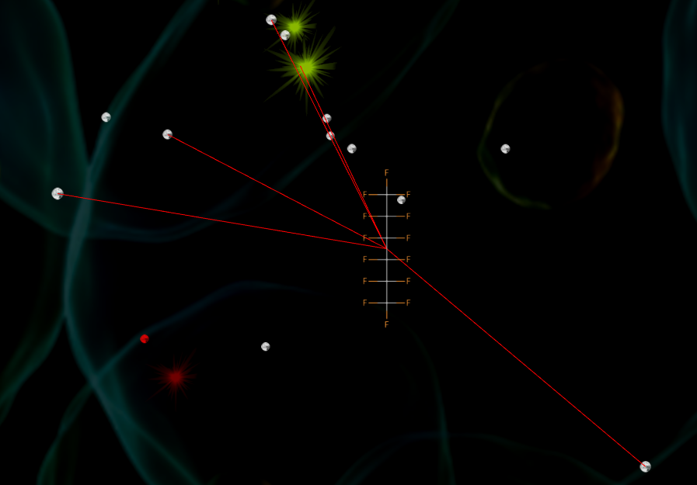
Interactive chemical panel
1.
2.
3.
4.
5.
6.
Selected chemical is in red on the map
3.
Link to EPA chemical dashboard
Connect neighbor chemicals on the maps
Focus the map on 1 to 20 chemical neighbors
Draw chemical selected on the map
Download a text file with 20 chemical neighbors including chemical descriptions and relative distance on map from the centered chemical
Link with the DSSToxMap
2.
4.

Slide 8
Control panel
1.
Select chemical by class, chemicals with GHS index, chemicals without GHS index or added chemicals. On the Tox21Map you can select chemicals with an AC50 reported and on the Drugmap you can select approved, withdrawn or in development drugs
Draw all chemical structures on the map (up to 50 chemicals)
Color panel, change the chemical color based on the selected properties on the map
Draw the axes from the origin
Move the map to be centered on the selected chemical, the view needs to be blocked to set a new pivot point
Reset the view in the origin
Reload the map
Link to the help page
2.
3.
4.
5.
6.
7.
8.

Slide 9
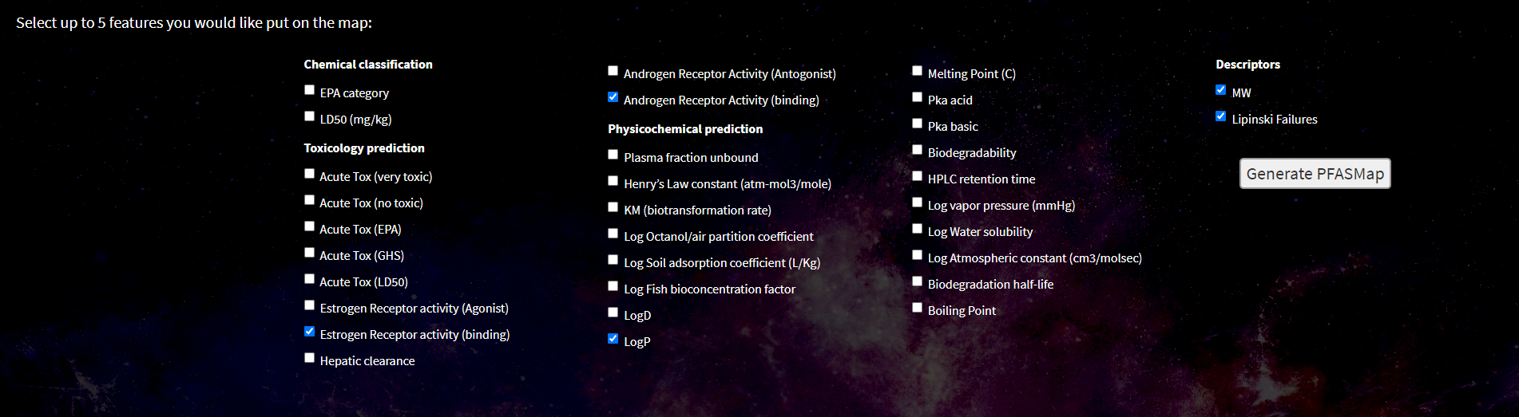


Personalized map
Project on the map up to 5 features including toxicology predictions, physicochemical predictions from OPERA and molecular descriptors from RDKit.

Slide 10
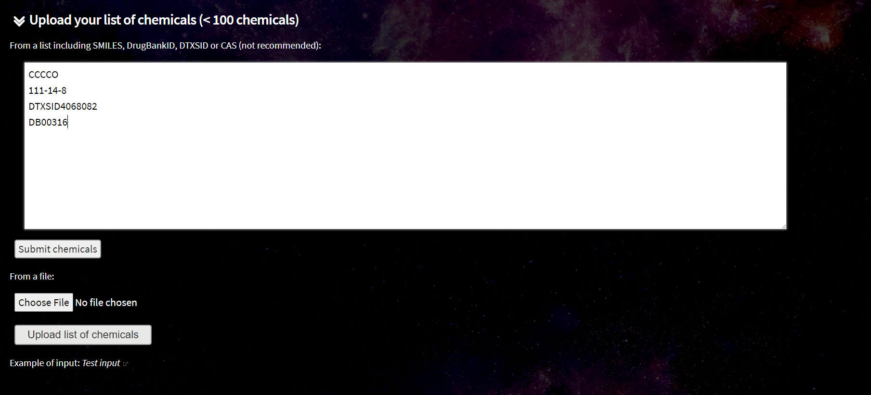
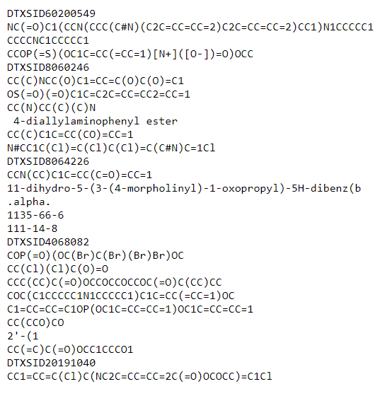
Add user chemicals
1.
2.
Add your chemicals manually in SMILES format or using CARSN, DTXSID or DrugBank ID
Submit to prepare your chemicals
Upload a list of chemicals in txt format
Click to see an example of a list of chemicals
3.
4.

Slide 11
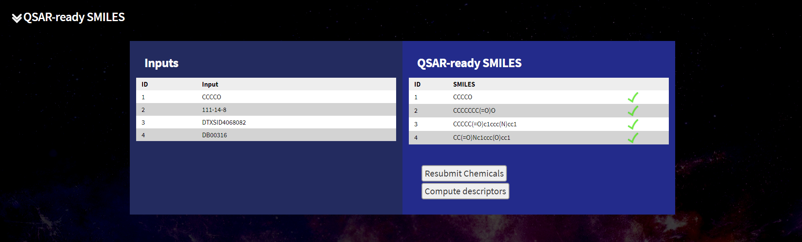
Prepare your chemicals
Compute molecular descriptors
Create QSAR ready structures from input chemicals

Slide 12
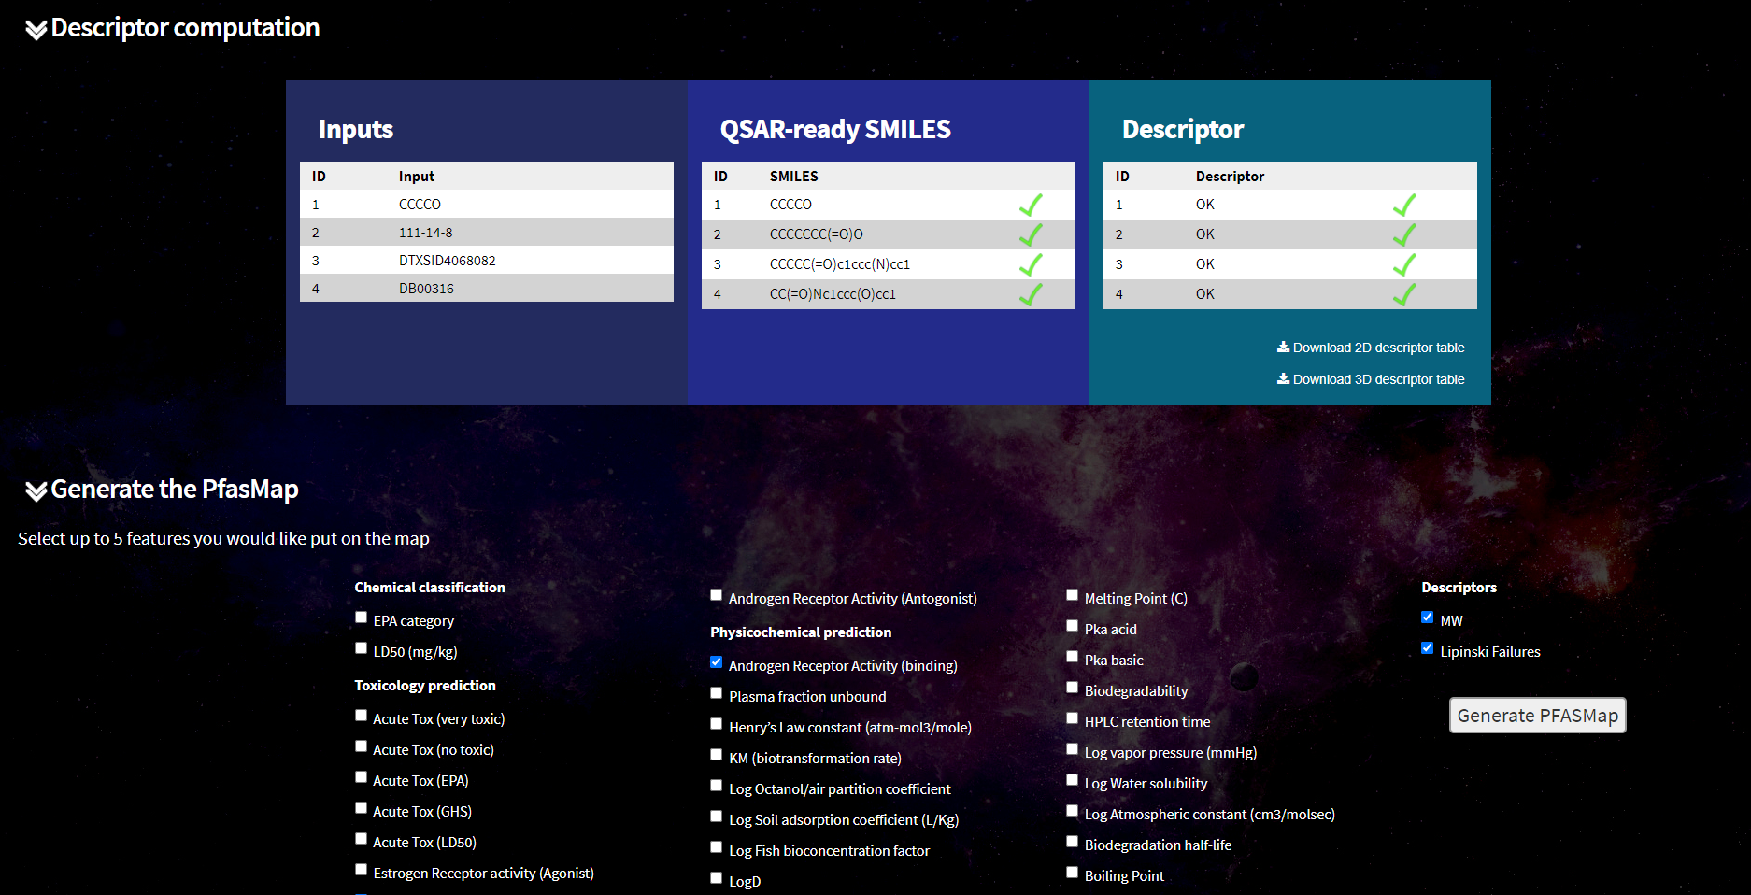
Compute molecular descriptors
Download 1D-2D descriptors
Download 3D descriptors
Select features to add on the map
Generate the map with the user chemicals
1.
2.
3.
4.

Slide 13
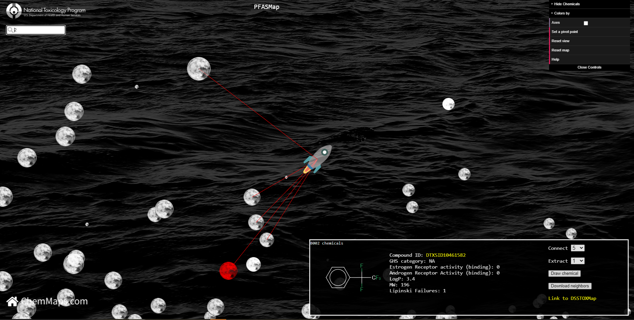
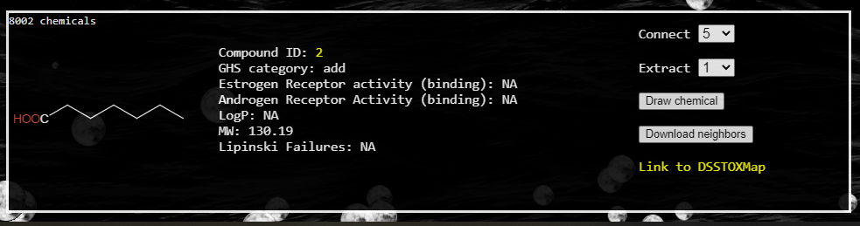
Map with user chemicals
1.
Search added chemicals by ID
Rocket represented added chemicals
Updated information about user chemical in the panel
2.
3.

Slide 14

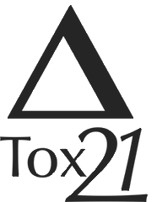
Project the Tox21 assay results
Project Tox21/ToxCAST assays results available in inVitroDB v3, data are available on the ICE platform (https://ice.ntp.niehs.nih.gov/)
1,337 assays available
394 assay targets identified
Projection on the Tox21Map:
8,947 unique substance comprising the screening library for the Tox21 program, a multi-federal agency collaborative among the US EPA, NEHS/NTP, NIH/NCATS, and the US FDA.
Active chemical
Inactive chemical
Inconclusive or no tested chemical

Slide 15
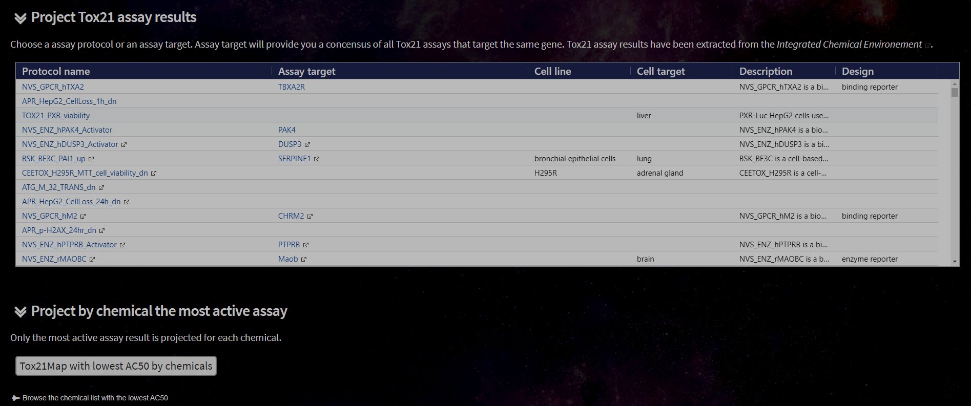
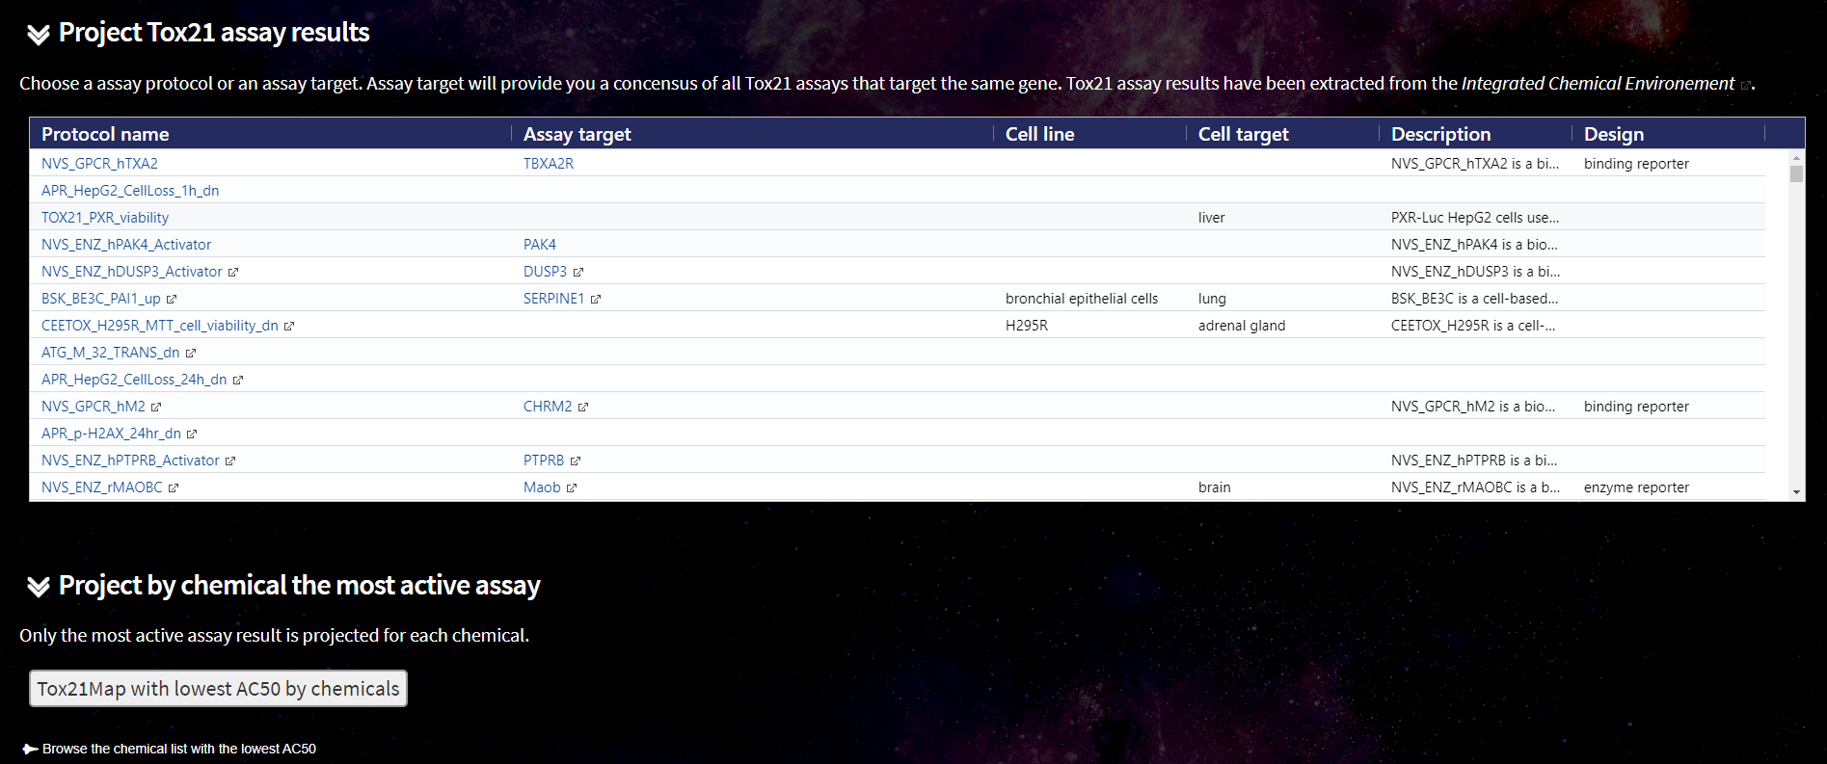
Select data to project
1.
2.
Project a unique assay results
Assay results for one target (combining several assays)
Project the lowest AC50 by chemicals
Browse chemical list with the lowest AC50
3.
4.

Slide 16
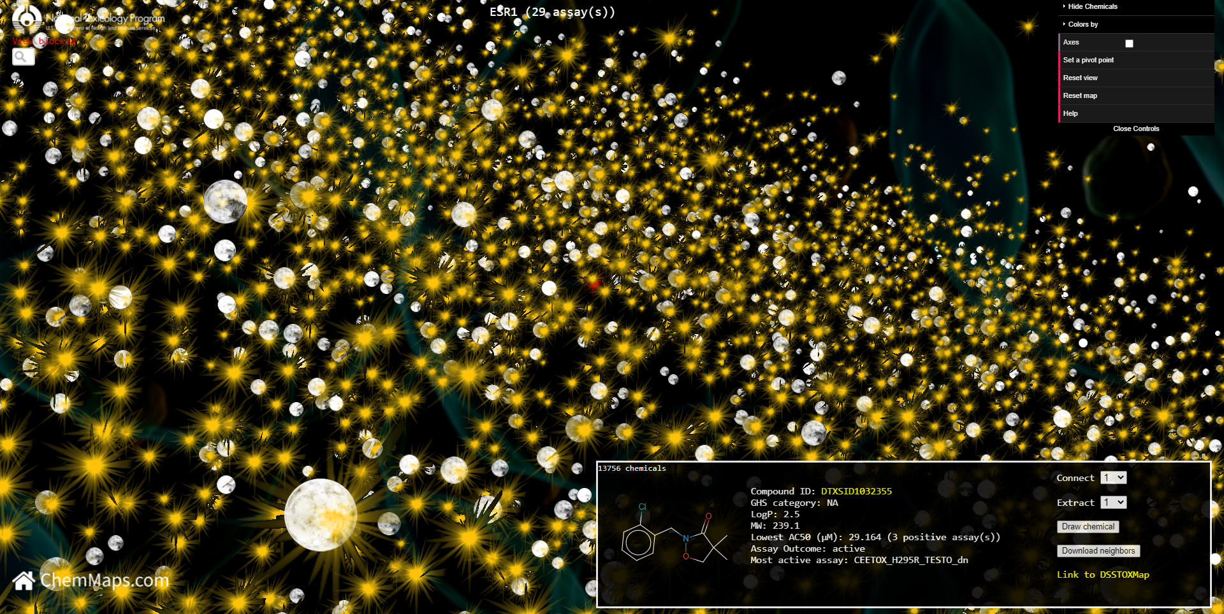
Assay results
1.
Show the name of the selected assay or selected target with the number of assay results projected on the map
Show the lowest AC50 with the number of assays active for a chemical
Show the assay name with the lowest AC50
2.
3.

Slide 17
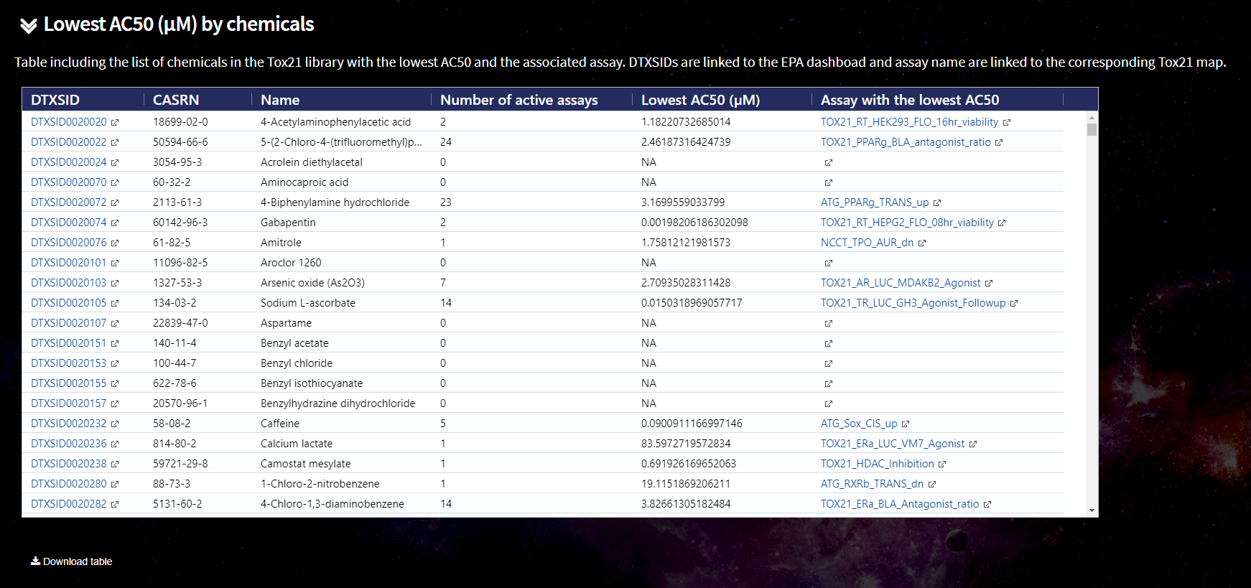

Chemical list with the lowest AC50
1.
2.
3.
4.
Link to the EPA chemical dashboard on the bioactivity page
Number of assay where the chemical has a AC50 value
Link to the Tox21Map with the most active assay results
Link to download this table in .csv format

